Slide 1
Global PSP Project for Indian Embassies and Consulates
Quick Guide – Update Fee Details Screen

Slide 2
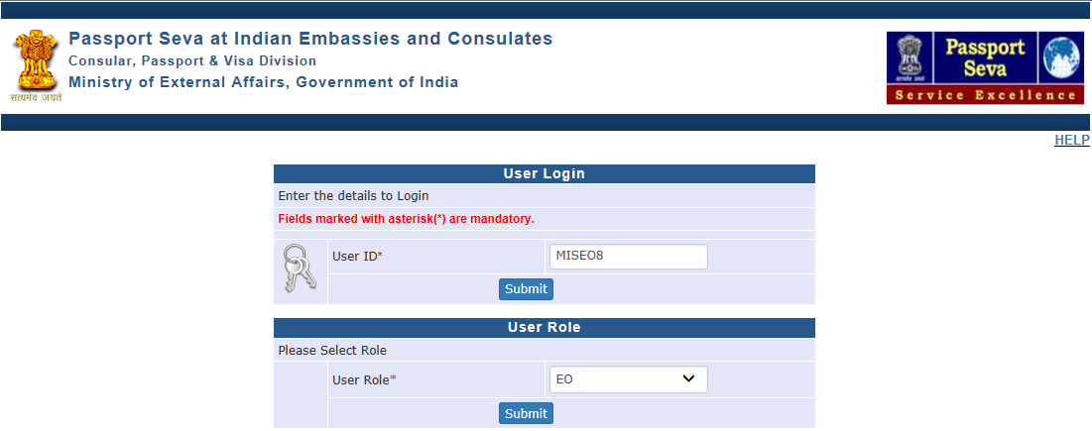
Login Using User ID, Password, and Grid Values
Visit Global PSP Office Portal (https://embassy.passportindia.gov.in)
Enter User ID
Press Submit button
Choose User Role as ‘EO’
Press Submit button displayed below the User Role

Slide 3
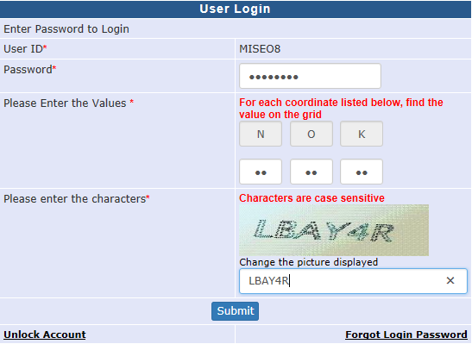
Login Using User ID, Password, and Grid Values (continued..)
Enter Password
Check your User Grid and enter the values for the three alphabets displayed on the screen
Enter the characters displayed in the CAPTCHA image
Press Submit button

Slide 4
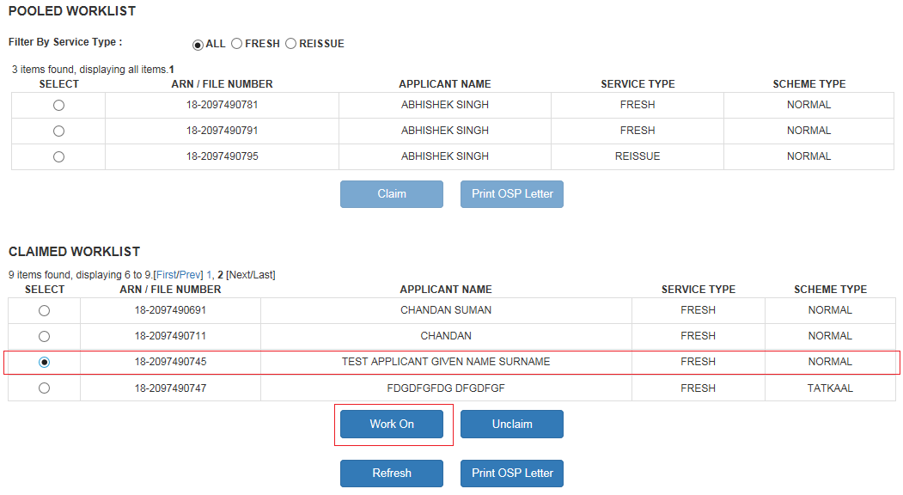
Process Enrolment Worklist
Click on the Link ‘Process Enrolment Worklist’ displayed in the Vertical Menu
Select the record to be displayed, Claim and open in Work on Mode

Slide 5
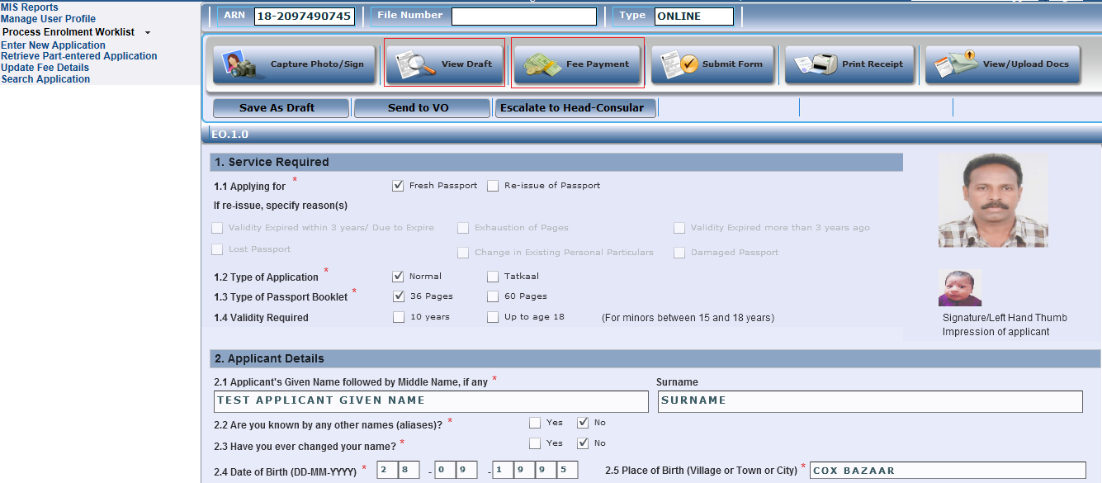
Process Enrolment Worklist (Continued..)
Click on the ‘Fee Payment’ button after viewing the Photo/Image and general details in the form, and pressing the ‘View Draft’ button

Slide 6
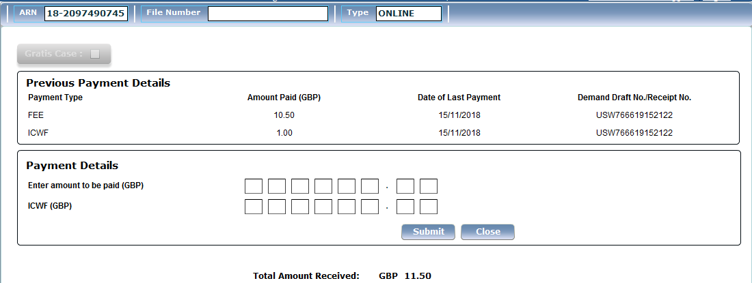
Process Enrolment Worklist (Continued..)
Validate the Fee Details Captured/Uploaded for the File, and press Close button.
Note:
In case any correction in fee amounts is required – that can be done through ‘Update Fee Details’ link after generation of File Number for the ARN by clicking the ‘Submit Form’ button in the current (‘Process Enrolment Worklist’) screen
Do not enter any payment details (in the displayed check-boxes) and submit unless you are actually collecting that from the applicant at Mission

Slide 7
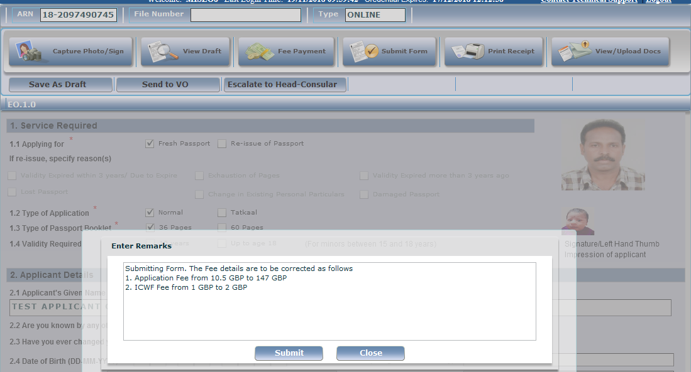
Process Enrolment Worklist (Continued..)
Submit Form after specifying due remarks related to need for correction in the fee amounts

Slide 8
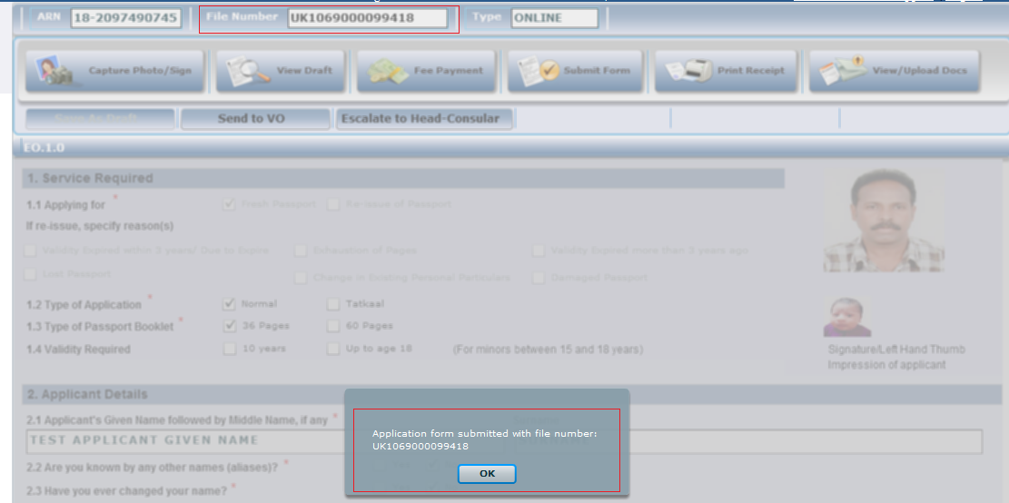
Process Enrolment Worklist (Continued..)
Copy the File Number generated after submitting the form. This will be required for making the corrections in the Fee details (amount and/or date) using the Update Fee Details link

Slide 9
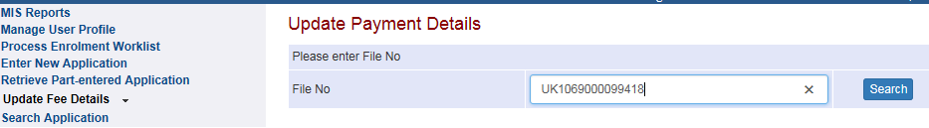
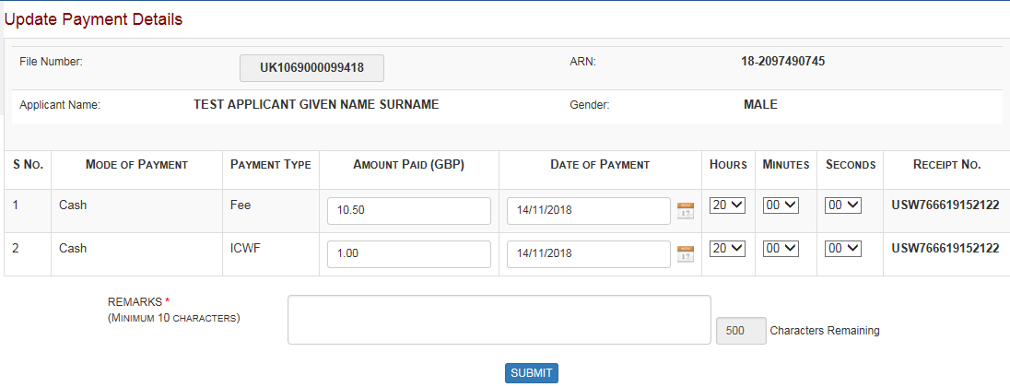
Update Fee Details screen
Click on Update Fee Details link
Enter File Number and press Search button
Existing Payment Records are displayed in the screen

Slide 10
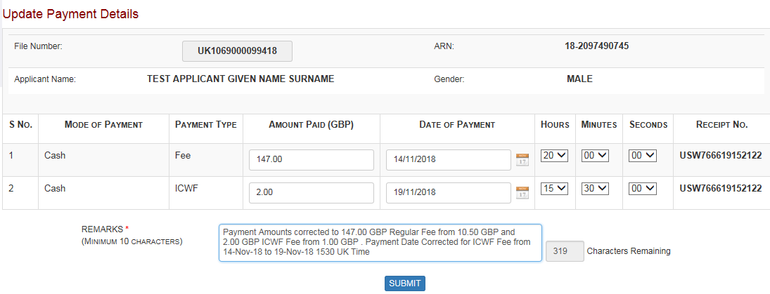
Update Fee Details screen (Continued…)
Make required corrections in fee amount (and date, if required)
Enter due remarks justifying the need for corrections
Press Submit button to save the changes in the payment details captured in the system

Slide 11
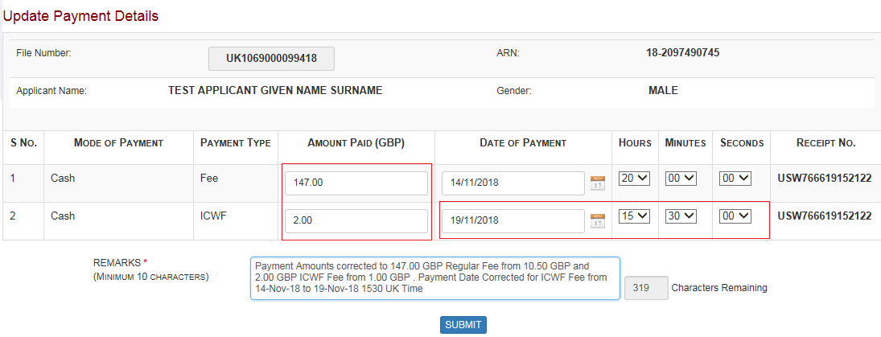
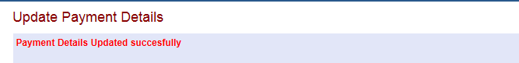
Update Fee Details screen (Continued…)
Make required corrections in fee amount (and date, if required)
Enter due remarks justifying the need for corrections
Press Submit button to save the changes in the payment details captured in the system. Success message will be displayed now.

Slide 12
Process Enrolment Worklist
Go back to Process Enrolment Worklist after submitting the changes in Fee details
Search the application in the worklist and open in Work on mode

Slide 13
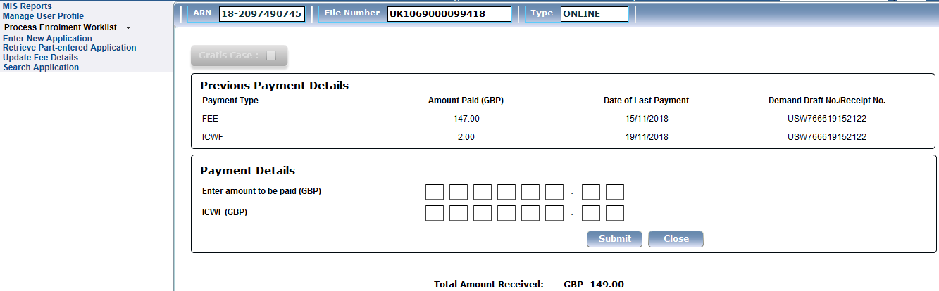
Process Enrolment Worklist (Continued…)
Review the corrections made in the Payment Details by clicking the Fee Payment button

Slide 14
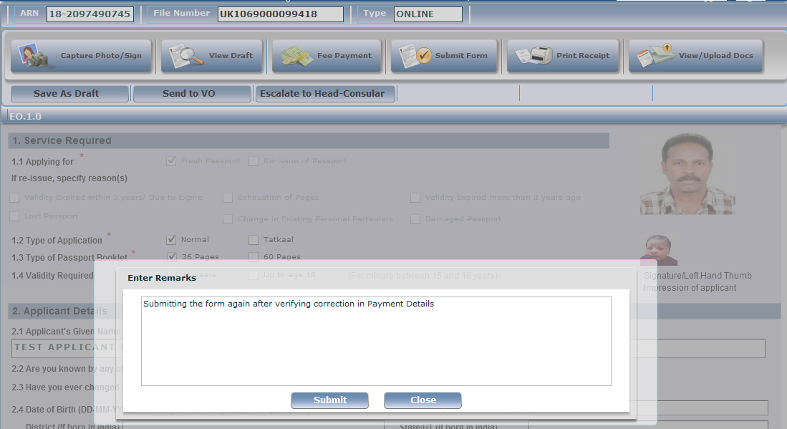
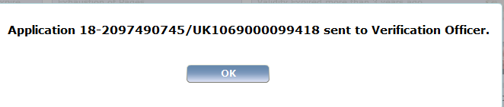
Process Enrolment Worklist (Continued…)
Submit the form again after entering due remarks, and Send to VO

Slide 15
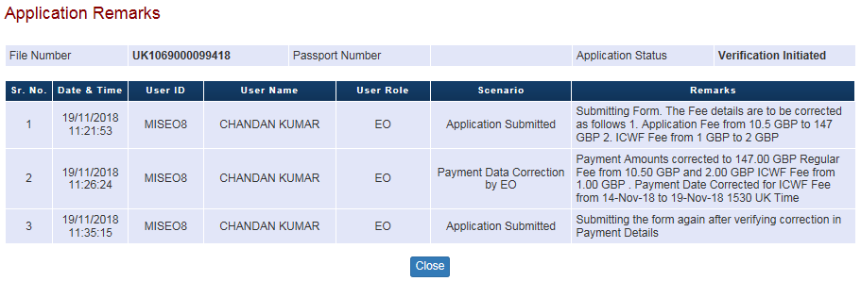
Search Application screen
All remarks entered by EO can be checked in Search Application → View Attachment → View Processing Remarks screen

Slide 16
In case of additional information or clarification, please contact Global PSP Support Team at
Email : global.psp@tcs.com
Phone : +91-0120-672-9595/96
Mobile : +91-730-351-9595
Thank You

